Slide 1
Musical Inferences
Vineeth Challagali
Venkat Nihaal Akula
Applied Statistics (Fall 1, 2019)

Slide 2
Context
What does a good song have ?
What characteristics of a song make it cut above the rest precisely into top 100 ?
Will the songs that make you groove reach to the top or the songs that make you melt.

Slide 3
Overview of Solution / contributions
Applying different statistical techniques on Top 100 songs of 2018 based on stream count on spotify.
Finding out different characteristics of a song and how they promote a song with respect to popularity quotient both individual and as a group.
Visualizing the distributions and correlations of the characteristics and to further gain inferences from them.
Applying inferential statistics on characteristic to reach to a conclusion regarding significance of the attribute.

Slide 4
Data Collecting and Preprocessing
The Data was imported from spotify , which had aggregated a playlist containing top 100 songs.
We observed that the data has no missing values as every song had some value for all the considered characteristics of the song.
As the songs were provided in the order of top 100 but for computational purpose we have added rank column and values.
The different characteristics that the song have are:
Quantitative: rank, danceability, energy key, loudness, mode, speechiness, acousticnes, instrumentalness, liveness, valence, tempo, duration_ms, time_signature
Qualitative: id, name, artists

Slide 5
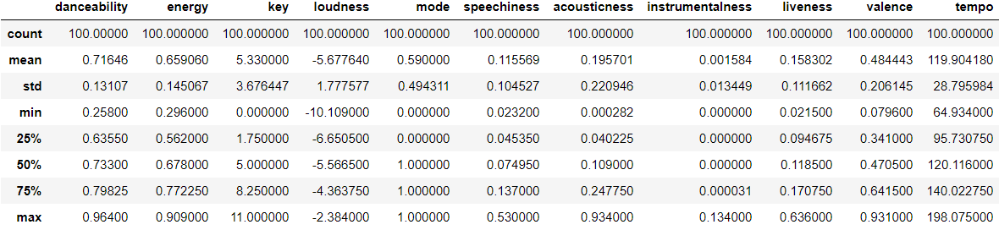
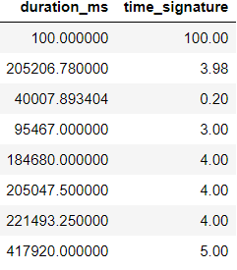
Statistical Methods
Initially descriptive statistics of all the quantitative columns was calculated.

Slide 6
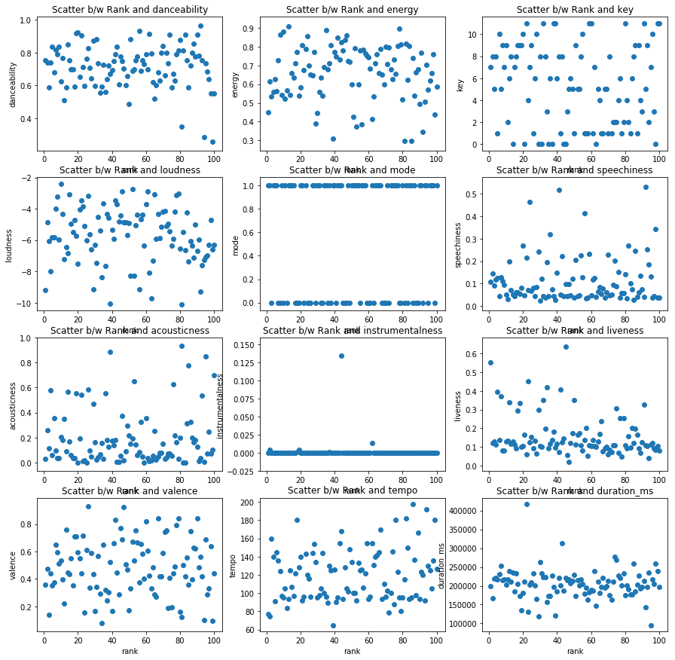
Statistical Methods
We plotted scatter plots between rank and each characteristic of the song individually.

Slide 7
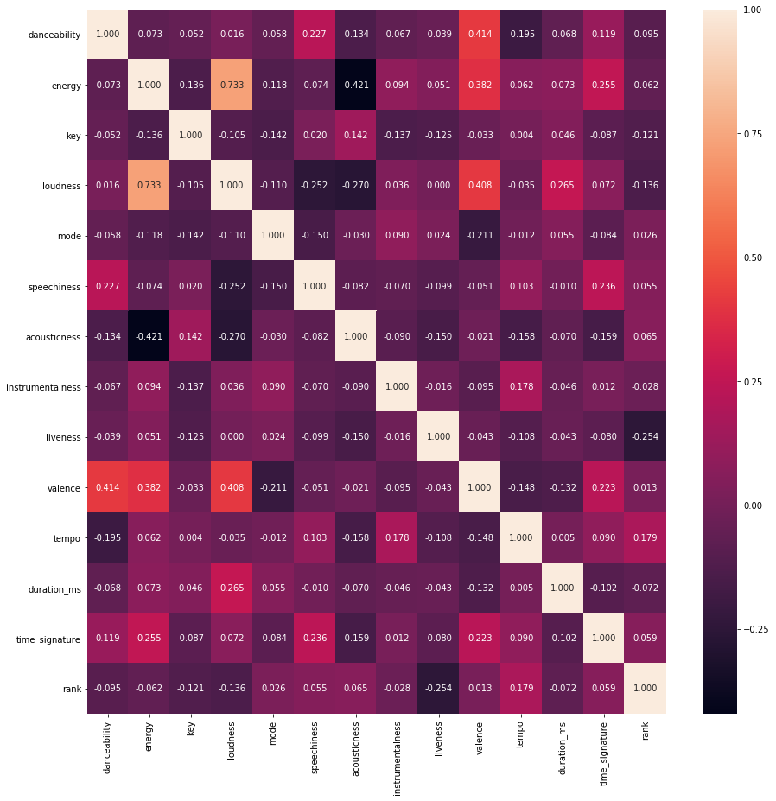
Statistical Methods
We constructed heat map among all the quantitative attributes to find the correlation among the variables.

Slide 8
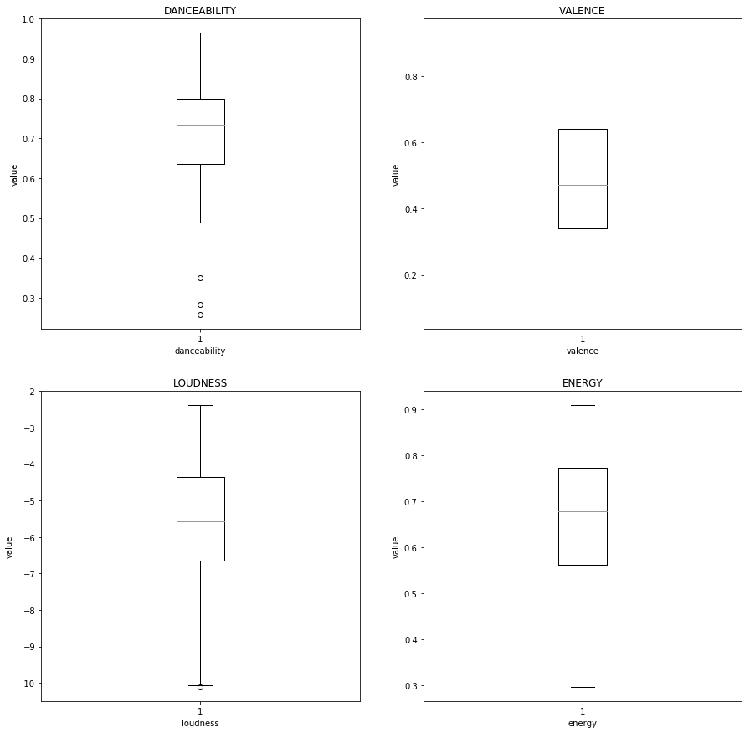
Statistical Methods
Box plots of the significant variables were constructed

Slide 9
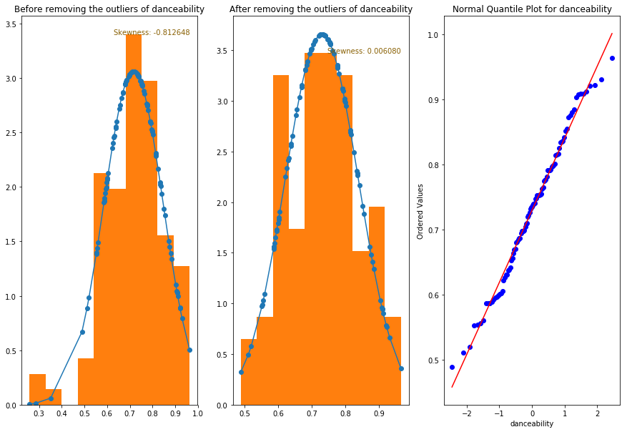
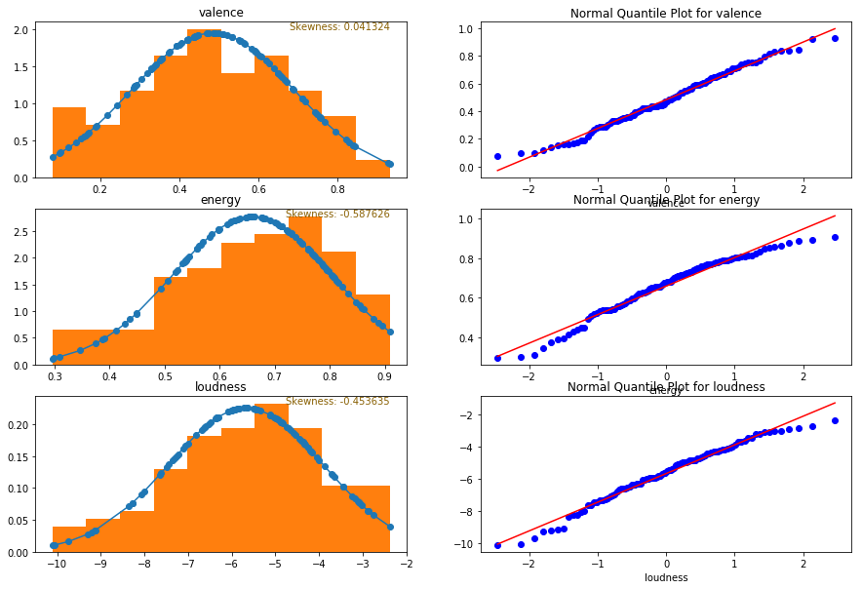
Statistical Methods
Histograms and the normal quantile plots are constructed

Slide 10
Evaluations – Performance – comparing
Hypothesis testing was performed for the claim that songs are majorly composed of energy (mean_energy>0.5).
H₀ =mean_energy = 0.5; H₁: mean_energy > 0.5.
Considering the significance level of alpha = 0.05.
T-distribution statistics was used and P-value was calculated, p-value=8.713371408794922e-19.
As the P-value is less than alpha, we can reject the null hypothesis and can simply state that
THERE IS SUFFICIENT EVIDENCE TO SUPPORT THE CLAIM THAT
THE SONG SHOULD BE MAJORLY COMPOSED OF ENERGY TO BE MORE POPULAR.

Slide 11
Lessons Learned and Perspectives
From the performed statistical inferences we deduced that there is no one single characteristic of the song that can push the popularity of the song.
There are 4 different attribute combinations that have a positive impact on the likeliness of the song.
Hypothesis testing of those variables just provides an enough base line to establish the significance of those characteristics.
Possible deviations:
Reputation of the artist can be a significant external factor that can push the popularity of the song.
Publicity provided to the song gives it a chance to reach to wider audience which is also an external factor that has considerable effect on popularity quotient.

Slide 12
Music is Language of Heart
Irrespective of all the inferences above, we all agree on a point that music is made from heart and souls not by measuring technicalities.
Song to sway or song to soothe all goes through heart.
Danceability, valence, Loudness and energy are just catalysts that help the transition of a song from studios to spotify top lists.

